Slide 1
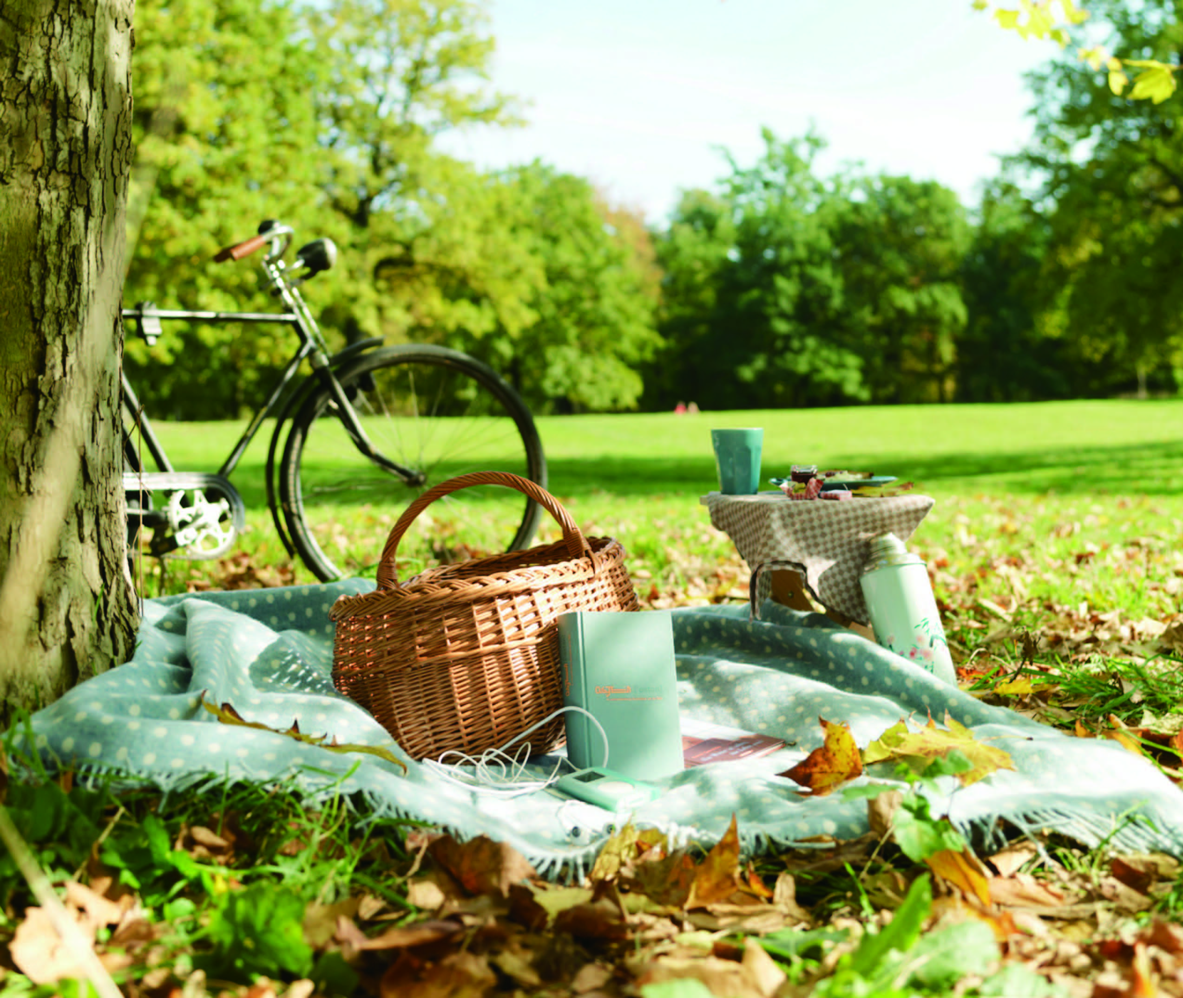
UNIT 3
Time out

Slide 2
Unit 3 Time out
Learning objectives
Opening up
Listening to the world
Speaking for communication
Further practice in listening
Wrapping up
Fun time

Slide 3

Learning objectives
1
Talk about leisure activities
2
Listen for information about plans
3
Manage phone problems
4
plan a perfect day

Slide 4
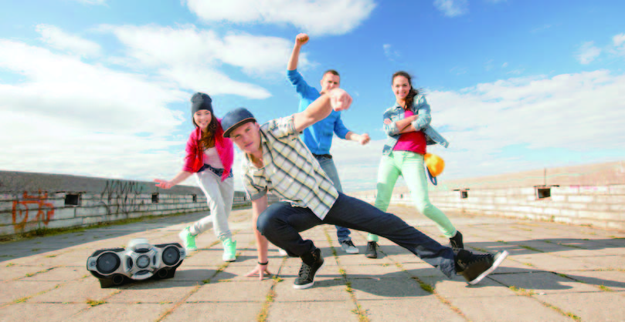
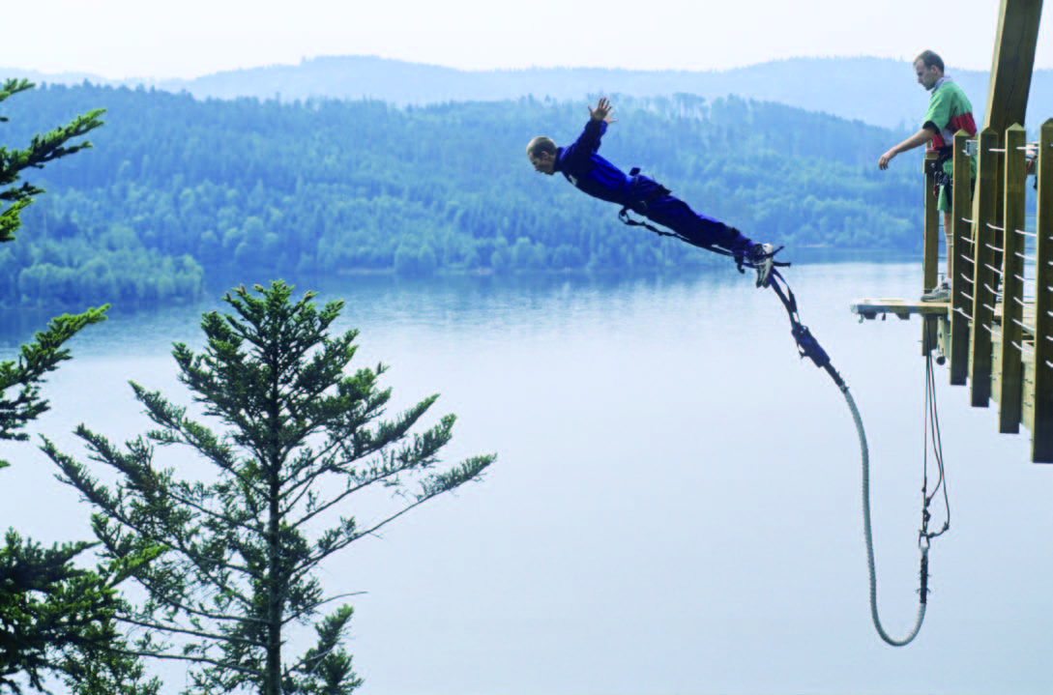

Opening up
1
Look at the pictures and read the activities. Then match the activities 1-6 to the pictures A-F
1 Street dancing
C
2 bungee jumping
E
3 flower arranging
D

Slide 5
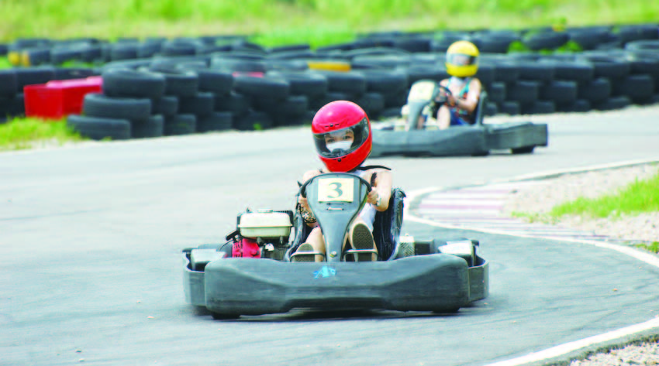
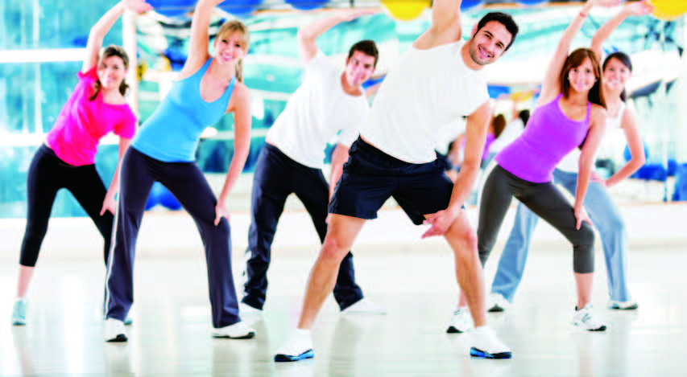
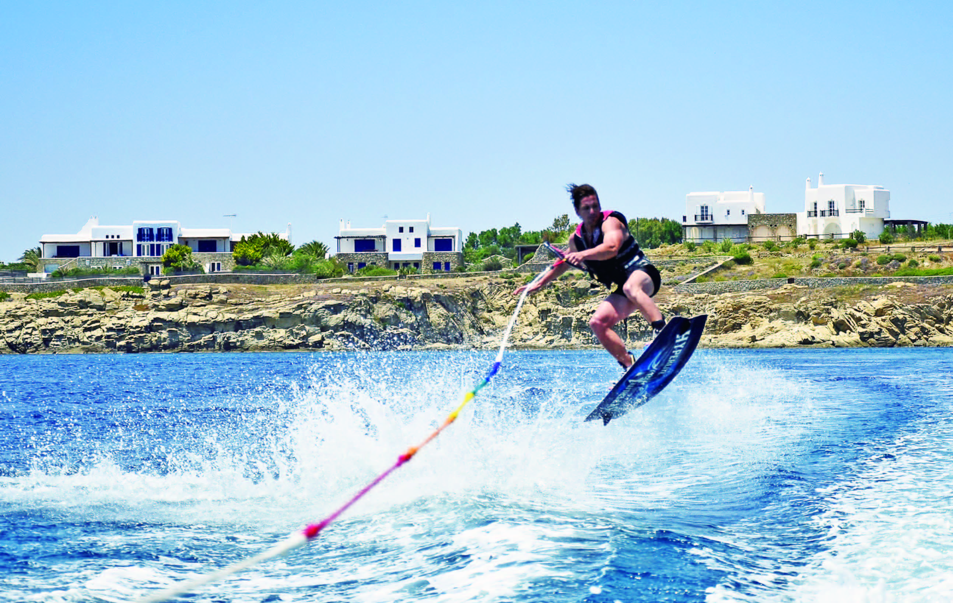
Opening up
1
Look at the pictures and read the activities. Then match the activities 1-6 to the pictures A-F
4 go-karting
A
5 aerobics
B
6 water skiing
F

Slide 6
Opening up
2
Work in pairs and discuss the question:
1 Have you ever tried the following leisure activities in your spare time?
☐ 1 snow skiing
☐ 2 street dancing
☐ 3 video games
☐ 4 camping
☐ 5 bungee jumping
☐ 6 rock climbing (攀岩)
☐ 7 horse riding
☐ 8 flower arranging
☐ 9 go-karting
☐ 10 aerobics
☐ 11 water skiing
☐ 12 stamp collecting
☐ 13 canoeing (划独木舟)
☐ 14 barbecue / BBQ (烧烤)
☐ 15 yoga (瑜伽)
☐ 16 jogging
☐ 17 cycling
☐ 18 Internet surfing

Slide 7
Opening up
2
Work in pairs and discuss the question:
2 Check (✔) the ones you have never done but long to have a try and give your reasons.
☐ 1 snow skiing
☐ 2 street dancing
☐ 3 video games
☐ 4 camping
☐ 5 bungee jumping
☐ 6 rock climbing (攀岩)
☐ 7 horse riding
☐ 8 flower arranging
☐ 9 go-karting
☐ 10 aerobics
☐ 11 water skiing
☐ 12 stamp collecting
☐ 13 canoeing (划独木舟)
☐ 14 barbecue / BBQ (烧烤)
☐ 15 yoga (瑜伽)
☐ 16 jogging
☐ 17 cycling
☐ 18 Internet surfing

Slide 8
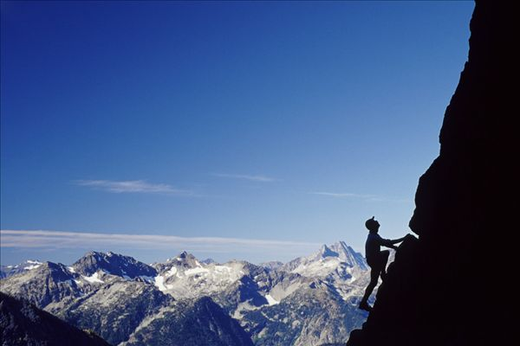
Opening up
2
Work in pairs and discuss the question:
2 Check (✔) the ones you have never done but long to have a try and give your reasons.
The activities I have never done but long to have a try is 6
(rock climbing).
Whenever I see photos or videos of rock climbers pulling themselves straight up the face of very high rocks or walls, I can’t help exclaiming, “That’s cool!” I admire rock climbers very much and I long to be one of them one day.

Slide 9
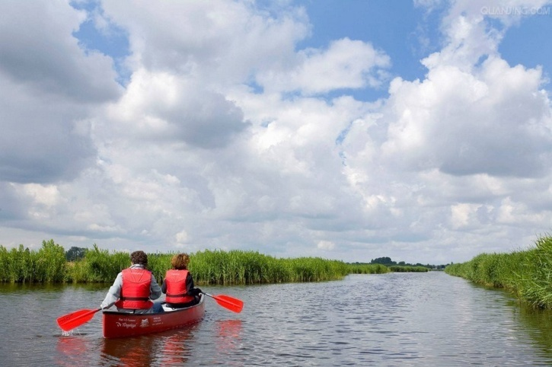
Opening up
2
Work in pairs and discuss the question:
1 Check (✔) the ones you have never done but long to have a try and give your reasons.
The activities I have never done but long to have a try is 13
(canoeing).
I went to New Zealand several years ago. There I could see canoes here and there. And I often saw people canoeing, the green water, colorful canoes, dark mountains, blue sky, and white clouds, all together forming an unforgettable picture in my mind.

Slide 10
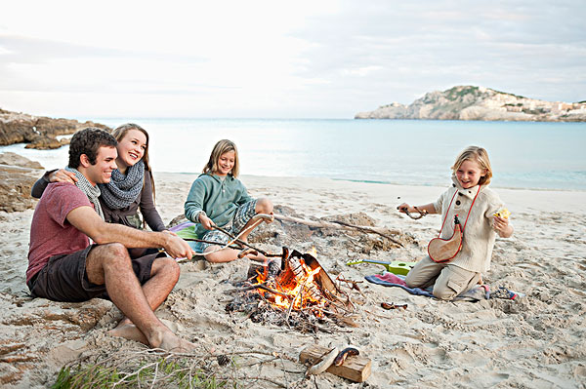
Opening up
2
Work in pairs and discuss the question:
1 Check (✔) the ones you have never done but long to have a try and give your reasons.
The activities I have never done but long to have a try is 14 (barbecue).
I have had only restaurant BBQ. But it's not real BBQ. What I have longed for is a convivial eating experience with my family or a group of friends cooking over the campfire outdoors. We hang around the fire, hold a beer in hand, and enjoy the meat and vegetables roasted over live fire.

Slide 11
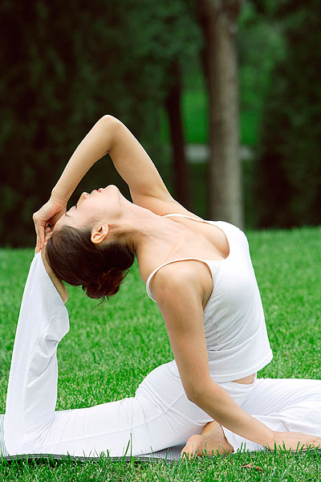
Opening up
2
Work in pairs and discuss the question:
1 Check (✔) the ones you have never done but long to have a try and give your reasons.
The activities I have never done but long to have a try is 15.
I have always had an interest in yoga. Yoga is relaxing and invigorating. It makes you feel good at the end of a session. More importantly, it results in better health, more inner peace and more passion for life.

Slide 12
Listening to the world
Sharing
Listening
Viewing

Slide 13
Listening to the world
Sharing
1
Watch a podcast for its general idea.
The podcast is mainly about what people like doing in their free time and what they are going to do this weekend.
2
Watch Part 1 and fill in the blanks.
1) concerts
2) a bar
3) band

Slide 14
Listening to the world
Sharing
3
Watch Part 2 and fill in the blanks.
1 keep fit
2 the theater
3 small children
4 seeing friends
5 eating and drinking
6 houses
7 having friends around
8 a jazz club
9 love to read
10 oil painting
11 playing the guitar
12 watching films

Slide 15
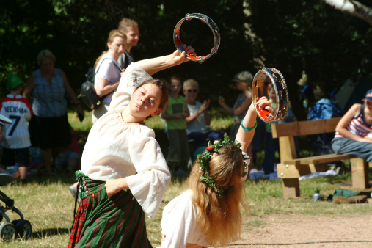
Listening to the world
Sharing
4
Watch Part 2 and fill in the blanks.
Additional Notes
Robin Hood Festival A festival that takes place for one week in August every year in Sherwood Forest, an ancient woodland in Nottinghamshire, England. The event celebrates the life and times of one of the most popular outlaws in the world: Robin Hood. Activities and entertainment include children’s theater, strolling players, jesters, jousting, and music.

Slide 16
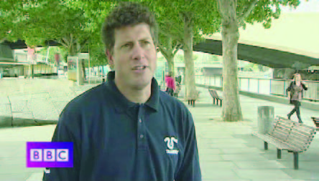
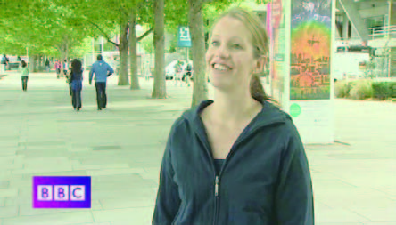
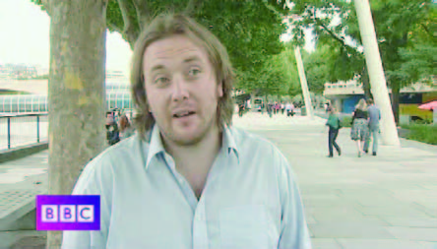
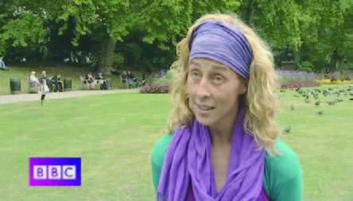
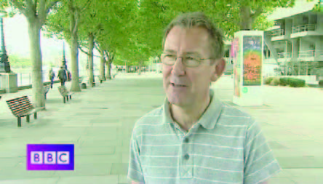
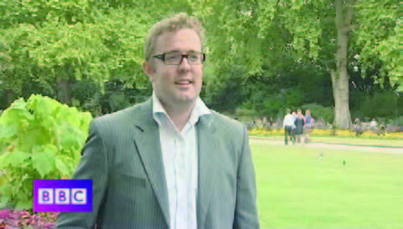
Listening to the world
Sharing
4
Watch Part 2 and check the true statements.
1
2
√
A
B
3
4
C
D
5
√
6
E
F

Slide 17
Listening to the world
Sharing
5
Work in pairs and tell your partner what you like doing in your free time and what you’re going to do this weekend. Use the prompts to help.
In my free time I enjoy doing a lot of sports such as yoga, jogging and hiking, and I love reading different kinds of books like detective stories, science fiction and biographies, because they not only enrich my life but also broaden my horizons. This weekend I’m going to see a lot of friends and go to a barbecue party at my friend’s house.

Slide 18
Listening to the world
Sharing
Listening
Viewing

Slide 19
Listening to the world
Listening
BEFORE you listen
1
Discuss the questions.
1 How much money do you usually spend when you go out for an evening?
Usually I spend about 200 to 300 yuan when I go out for an evening.
2 Where do you usually go in your leisure time? What do you usually do? How much money do you spend on each activity?
Quite often I go to a bookstore to buy some books, which may cost me 50 to 100 yuan. Then I have some coffee or some ice cream, and it’s about 50 yuan. After that, I may go to the cinema to see a movie, which may cost me around 100 yuan.

Slide 20
Listening to the world
Listening
Listening skills
Additional Tips
Listening for information about plans Timeline is a useful tool to take note of information about plans. A timeline is a visual method of displaying a list of events in chronological order, typically a long bar with dates and events labeled alongside itself, as shown below.
Event:
Date:
Event:
Date:
Event:
Date:
Event:
Date:
Event:
Date:
Event:
Date:
Event:
Date:

Slide 21
Listening to the world
Listening
Listening skills
Additional Tips
Listening for information about plans Timelines can be used for organizing future projects and events. For example, a timeline can be used to organize the details for an upcoming wedding by specifying on what days to go dress shopping, what days to pick up decorations, etc. It can also be used in a business plan to outline the steps to accomplish a business goal and how long each step will take. It may also be used to visualize your goal of losing weight by listing the pounds you want to lose every week or month. So timelines are an effective way of graphically organizing the details and requirements of events that are being planned.

Slide 22
Listening to the world
Listening
While you listen
2
Listen and complete the table.
 | Signal words and expressions | Plans
Dominique | First of all | I’m going to 1) ____________________ at the Tate Modern.
 | Then | I’m meeting some friends and we’re 2) ____________________ at a pub called The King’s Head.
 | Afterwards | We’re 3) ____________________ in Brick Lane.
 | Then | I’m 4) __________________.
see a free art exhibition
going to a concert
having dinner
getting the bus home

Slide 23
Listening to the world
Listening
While you listen
2
Listen and complete the table.
 | Signal words and expressions | Plans
Rob | I’m starting the evening with … | I’m starting the evening with 5) ____________________, too. I’m going to the National Gallery to see the 6) ____________ there.
 | Then | I’m going to Covent Garden to 7) _____________________________.
 | And after that | I’m going to 8) ____________________. There’s a really good 9) ____________________ just near Covent Garden.
a visit to a museum
painting
watch the street entertainers
watch some comedy
comedy club

Slide 24
Listening to the world
Listening
AFTER you listen
4
Discuss the questions.
1 What do you think of the two plans? Which things would you like / not like to do?
I think both the plans are feasible. They are well thought out in that each plan contains details as to what to do and how to control the expenses. If I were to make the plan, I would most possibly cut having dinner at the Indian restaurant from the first plan. I simply dislike Indian foods.

Slide 25
Listening to the world
Listening
AFTER you listen
4
Discuss the questions.
2 How will you spend an evening out in your city with no more than 30 yuan?
I live in Shanghai. First of all I’m going to Yuyuan Market, which is a lively market specializing in traditional Chinese arts and crafts. And I can also try some Shanghai Xiao Long Bao, which may cost me about 15 yuan. Then I’m going to Nanjing Road Pedestrian Street by bus, which offers all-in-one shopping malls and spectacular night views. After that I’m going back to school by taking the subway.

Slide 26
Listening to the world
Sharing
Listening
Viewing

Slide 27
Listening to the world
Viewing
BEFORE you view
1
Read the program information below and answer the questions.
1 What do you know about Barcelona in Spain?
I don’t know much about Barcelona. I just know it’s a popular tourist attraction in Spain, and it hosted the highly successful 1992 Summer Olympics and several matches during the 1982 FIFA World Cup.

Slide 28
Listening to the world
Viewing
BEFORE you view
1
Read the program information below and answer the questions.
2 Would you like to go there? Why or why not?
Yes, I would like to go there very much, because it is said to be one of the most beautiful cities in the world, and is viewed as the “Paris of Spain” by many people.

Slide 29
Listening to the world
Viewing
While you view
2
Watch Part 1 and fill in the blanks.
1) sightseeing
2) beach
3) get away from
4) relaxing
5) a dozen
6) fantastic
7) attitude
8) perfect

Slide 30
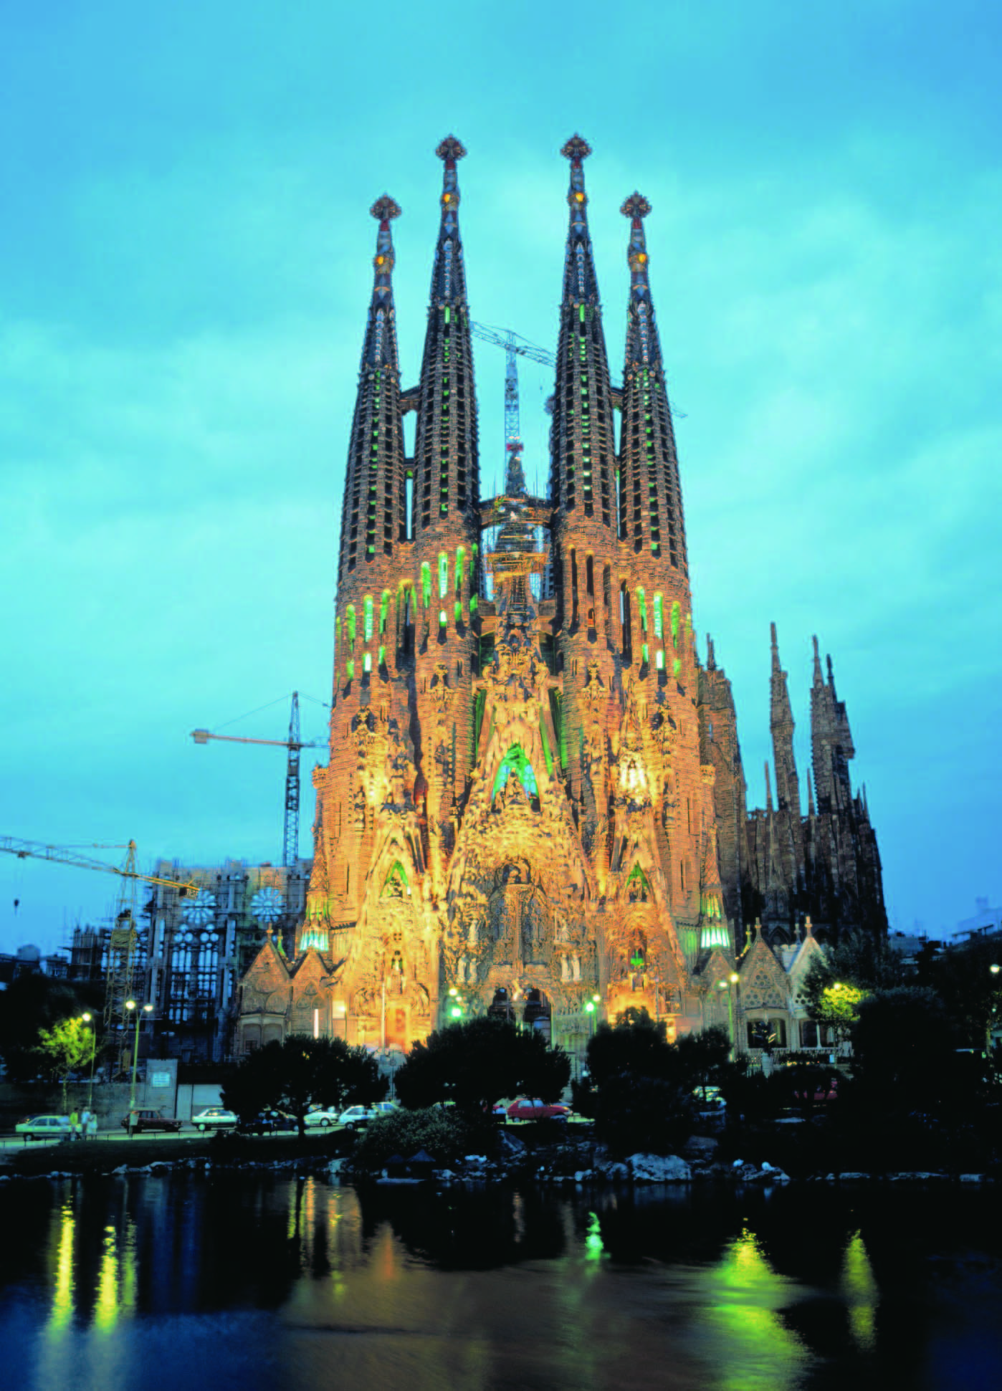
Listening to the world
Viewing
WHILE you view
3
Watch Part 2 and choose the activities that the presenter suggests for the perfect day in Barcelona.
10:00
11:00
13:00
16:00
18:00
22:00
b
a
a
b
a
b

Slide 31
Listening to the world
Viewing
WHILE you view
4
Watch Part 2 and match what the presenter says to the time she is talking about.
10:00
11:00
13:00
16:00
18:00
22:00
c
e
f
b
a
d

Slide 32
Listening to the world
Viewing
AFTER you view
5
Discuss the questions.
1 Would you enjoy any of the things the presenter talks about? Which ones?
What I would enjoy most is La Sagrada Familia which is such a magnificent and yet strange-looking building that I think no visitor should miss it. I would also like to visit the Ramblas very much because I love markets just like the presenter.

Slide 33
Listening to the world
Viewing
AFTER you view
5
Discuss the questions.
2 Would you make any different arrangements if you were the presenter?
If I were the presenter, perhaps I would get up earlier and have a walk in the streets because I would like to see how ordinary people in Barcelona work and live, not just go to those tourist attractions.

Slide 34

Speaking for communication
Role-play
1
Listen to four people making phone calls and complete the notes.
Conversation 1
King’s Restaurant
Reasons for calling:_______________.
Rodney Collins, table for four people.
Day:____________. Time:__________.
Book a table
Saturday
10 o’clock

Slide 35
Speaking for communication
Role-play
1
listen to four people making phone calls and complete the notes.
Conversation 2
High Tower Productions
Reasons for calling:
______________________________.
Two tickets for Judy ____________.
Original date: ____________.
New date: _____________________________.
Change the date of two tickets
Starr
June the fifth.
June the ninth / the ninth of June

Slide 36
Speaking for communication
Role-play
1
listen to four people making phone calls and complete the notes.
Conversation 3
Reasons for calling: _________________________________
Dinner with Wendy and their friends.
Zanzibar’s at _________on _______ night.
Conversation 4
To: Sarah Hobbs. Caller: Andy Jones.
Message: Cancel_______________. Please call back on _______________.
Arrange to have dinner with friends
eight thirty
Saturday
dinner tonight
0988 45673

Slide 37
Speaking for communication
Role-play
2
Listen to the conversations again and write down the expressions used in these situations in the conversations.
1 Can you repeat that, please? Did you say …?
2 Can I just check?
Sorry, I didn’t catch that. Did you say …?
Sorry, can you slow down, please?
3 Can you speak up, please?
4 Can you repeat that, please?

Slide 38
Speaking for communication
Role-play
Speaking skills
Additional Tips
Managing phone problems A telephone conversation is a complex process with special challenges.
Phone problems | Expressions for managing Phone problems
You need to place the caller on hold. | • She is talking on another line. Would you care to wait, or may I have her return your call? • I’m sorry, but Mr. Venter is on the other line. May I have him return your call later today? • He is working with another customer at the moment. Would you like to hold, or would you prefer to leave a message?

Slide 39
Speaking for communication
Role-play
Speaking skills
Additional Tips
Managing phone problems A telephone conversation is a complex process with special challenges.
Phone problems | Expressions for managing Phone problems
A caller has reached you by mistake and you want to transfer him / her to someone else. | Mary in the Personnel Department will be able to answer your questions. I’d like to transfer you to her line. Is that all right with you?

Slide 40
Speaking for communication
Role-play
Speaking skills
Additional Tips
Managing phone problems A telephone conversation is a complex process with special challenges.
Phone problems | Expressions for managing Phone problems
You ask to be put through to someone else. | • Could you put me through to the Quality Control Department, please? • May I have the Accounting Department, please? • I’d like to speak with someone who deals with complaints.

Slide 41
Speaking for communication
Role-play
Speaking skills
Additional Tips
Managing phone problems A telephone conversation is a complex process with special challenges.
Phone problems | Expressions for managing Phone problems
There is not anyone to answer the telephone and you have to leave a message on an answering machine. | • Hello, this is Mary calling for Sylvia. Could you please return my call as soon as possible? My number is 996-5759. Thank you. • Hello Peter. This is Marina from the dentist’s office calling. I just wanted to remind you that you have an appointment Friday morning. Please give us a call when it’s convenient.

Slide 42
Speaking for communication
Role-play
5
Role-play the situations.
Situation 1
Inviting a friend to a movie
B: Hello? A: Hello, it’s Sylvia here. B: Oh hi, Sylvia. How are you? A: Not bad. Are you doing anything tonight? I’ve got two tickets for the movie The Lord of the Rings at 8:00 p.m. Will you go with me? B: Oh, that’s great. Where shall we meet? A: Seven forty-five p.m. at the Grand Theater. B: Which theater? I’m afraid I didn’t catch that. A: The Grand Theater. B: Brilliant. See you then. A: OK. See you.

Slide 43
Speaking for communication
Role-play
5
Role-play the situations.
Situation 2
Changing a reservation
B: Brandon’s Restaurant. Can I help you? A: Hello, I was wondering if you could help me. I’ve booked a table for five on Tuesday, but I’d like to change that. B: OK, one moment. Can I just check? What’s the name, please? A: The table is booked in the name of Damian Williams. B: Damian Williams. OK, yes. A table for five on Tuesday. How would you like to change it? A: I’d like to change to 8:00 p.m. next Wednesday. B: Let me just have a look. Yes, we have a table for five at 8:00 p.m. next Wednesday.

Slide 44
Speaking for communication
Role-play
5
Role-play the situations.
(continued)
Changing a reservation
A: Have you got a larger table? There will now be 10 people, not five. B: Nothing bigger, I’m afraid. But we have another table for five. If you don’t mind, we can put the two tables together. A: That’s fine. B: OK. So 8:00 p.m. next Wednesday, turn two tables for five into a larger table for 10. I’ll go ahead and book that. A: Thank you. B: You’re welcome.

Slide 45
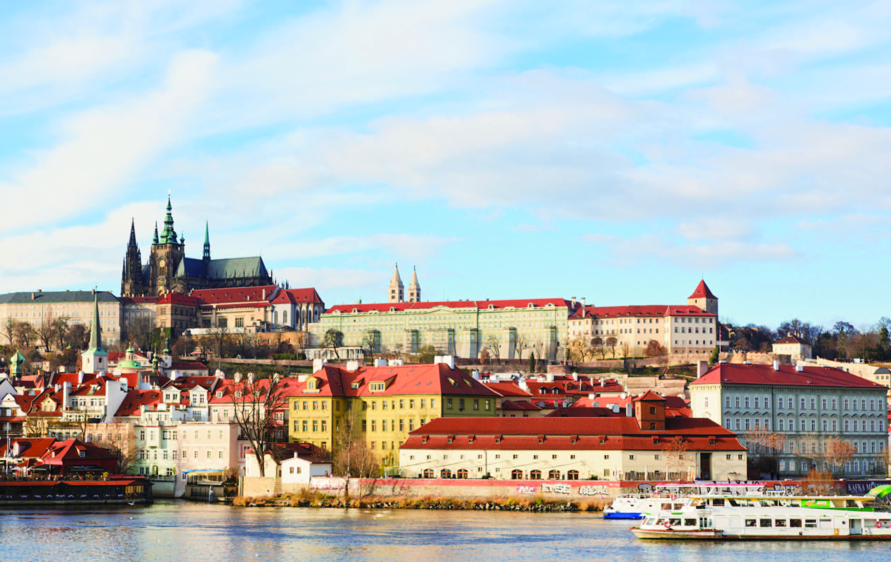
Speaking for communication
Group discussion
Get ideas
1
Listen to a woman talking about her plans for a perfect day out and number the activities in the order she talks about them.
e-d-b-f-a-c

Slide 46
Speaking for communication
Group discussion
Get ideas
1
Read the key phrases and the statements 1-5. Then listen to the talk again and use the key phrases
to complete the statements 1-5.
a-2
b-1
c-3
d-5
e-4

Slide 47
Speaking for communication
Group discussion
Discuss and organize ideas
2
Discuss and fill in the table
Time / Order | Places | Activities
After breakfast
After that
After lunch
The northern bank of the Seine
Observe the 360-degree view of Paris’ most famous sights from Place de la Concorde
See Monet’s Water Lilies as well as paintings by other famous painters
The Musée de l’Orangerie
The Eiffel Tower
See the Eiffel Tower

Slide 48
Speaking for communication
Group discussion
Discuss and organize ideas
2
Discuss and fill in the table
Time / Order | Places | Activities
After that
In the evening
The Jardin des Plantes
Visit a winter garden, tropical greenhouses, an alpine garden, and a menagerie
The Musée de l’Orangerie
Take a stroll over the lamp-lit bridge
Sip champagne in hotel bars
Dine in candle-lit pubs

Slide 49
Speaking for communication
Group discussion
Present ideas
4
Present your ideas to the class.
I’m going to tell you about my perfect day in Paris. First of all, after breakfast, we’re starting the day on the northern bank of the Seine, to observe the 360-degree view of Paris’ most famous sights from the Place de la Concorde.
After that, we’re going to the Musée de l’Orangerie (Orangerie Museum) to see Monet’s Water Lilies as well as paintings by other famous painters.

Slide 50
Speaking for communication
Group discussion
Present ideas
4
Present your ideas to the class.
After lunch, we’re going to wander west along the Seine to the Eiffel Tower. After we’ve admired Paris’ greatest viewpoint, we’re going to catch a Batobus – a hop-on, hop-off waterbus – to the Jardin des Plantes, which includes a winter garden, tropical greenhouses and an alpine garden, as well as a menagerie.
In the evening, we’re planning to take a stroll over the lamp-lit bridges. Strolling over the bridges at dusk as the lamps cast a glow on the darkened water, sipping champagne in hotel bars, and dining in candle-lit pubs make you feel as if you’ve stepped onto a giant film set. It’s going to be romantic and fantastic!

Slide 51
Further practice in listening
Short conversations
1 Q: What can we infer from this conversation about the woman?
D She once wore high-heeled shoes during a long walk.
2 Q: What does the woman suggest the man do?
C Add flavor to the barbecue sauce with Coke.
3 Q: How much should the woman pay?
D $55.
4 Q: What do we know from the conversation about the woman?
B She is not very confident in her own figure.
5 Q: What does the woman mean?
C She cannot save herself if she falls into water.

Slide 52
Further practice in listening
Long conversation
1 Q: What do we know about those people who are invited to the party?
D They are likely to dress like people in the 1960s.
2 Q: What is particular about alien noodles?
A They are brightly colored .
3 Q: Why won’t they have regular noodles at the party?
A Because regular noodles don’t fit the theme of the party.
4 Q: What other arrangements do they have for the party?
D They will make and have fancy mixed drinks.

Slide 53
Further practice in listening
Passage 1
1 Q: What do we know from this passage about the speaker?
A He will soon graduate from school.
2 Q: What does the speaker like doing on weekends?
A Going for long walks in the countryside.
3 Q: How do the speaker and his friends spend the day when they go canoeing?
D Drifting down the river.
4 Q: What does the speaker most like doing when camping in the evening?
D Cooking potatoes in the hot ashes.

Slide 54
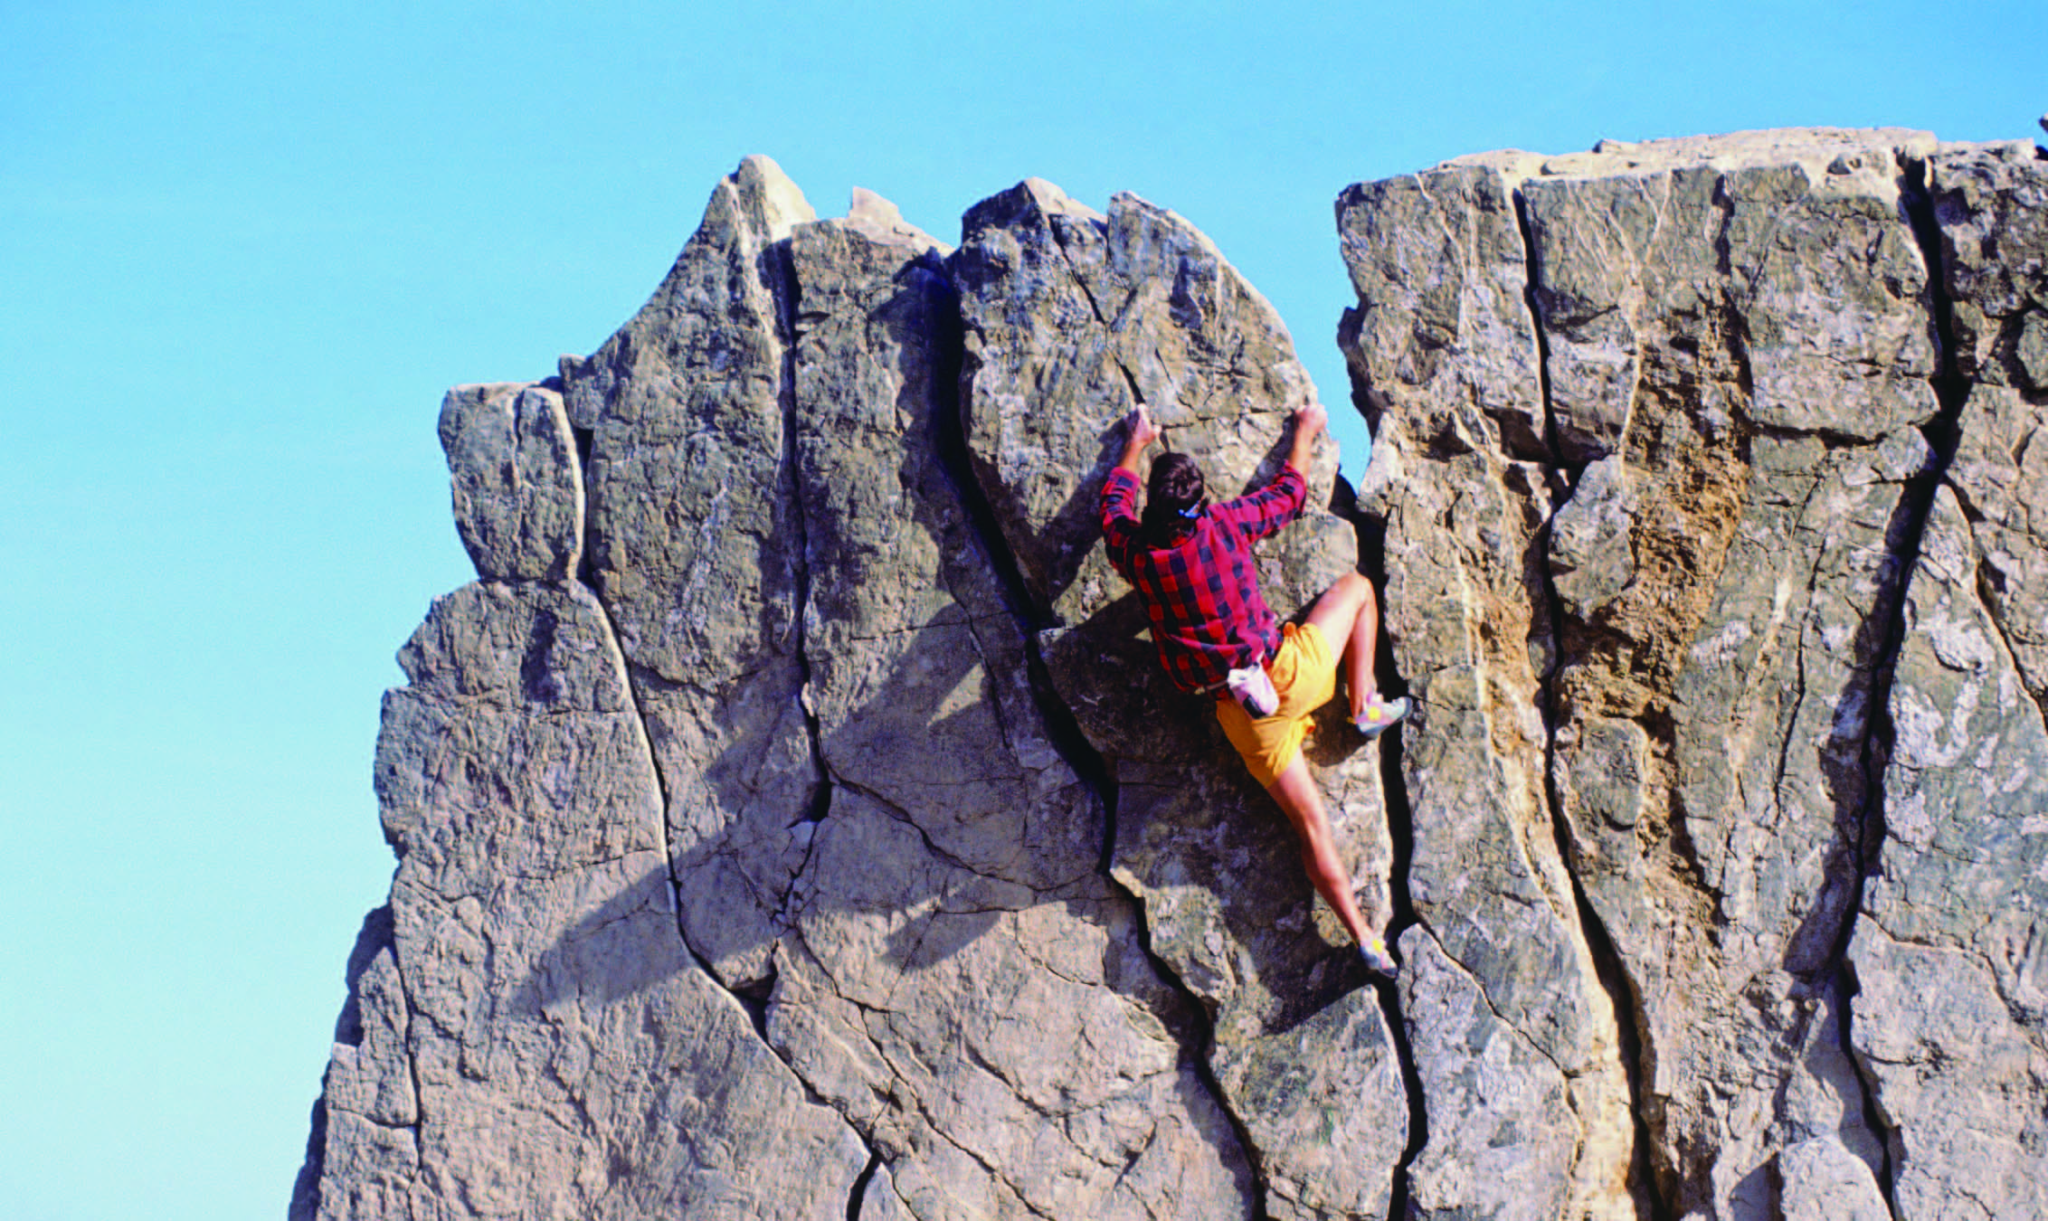
Further practice in listening
Passage 2
1) objectives
2) farthest
3) recognized
4) separated into
5) involves
6) is referred to
7) life-threatening
8) designed

Slide 55
Wrapping up
Use the following self-assessment checklist to check what you have learned in this unit.
Skills | OK | Needs work
I can talk about my learning experiences.
I can listen for signal words for listing.
I can give and respond to advice.
I can discuss learning / teaching methods.

Slide 56
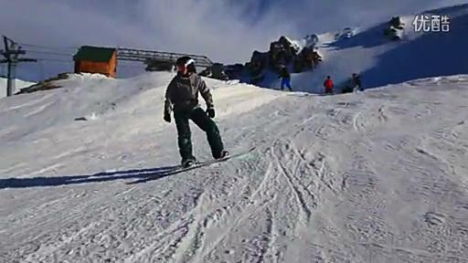
Fun time
Enjoy a video about a seven-day South Island snow safari.

